Slide 1


Slide 2

AppTrader Proposal
April 2020
Notes:
Welcome ladies and gentleman, we are happy that you choose Hawkeye Data Analysis to assist you with the apps you are purchasing marketing rights to for your Memorial Day launch.

Slide 3




HAWKEYE DATA ANALYSIS
Pam Butler
Jacob Arevalo
Nicole Muldowney
Cat Schmalzer
Data Analyst
Data Analyst
Data Analyst
Data Analyst
Notes:
Here is our team of Data Analysts, made up of...

Slide 4
PROJECT OBJECTIVE
To recommend the 10 Best Mobile Apps for the AppTrader Launch
Notes:
Cat is up next to talk about the focus points for our analysis.

Slide 5
ANALYTICAL FOCUS POINTS
Price
Genre
Rating/Reviews
Notes:
Upon analyzing the data in both App stores, we felt that price, genre and ratings and reviews would be the primary factors driving our decision-making and delivering what you asked for.

Slide 6
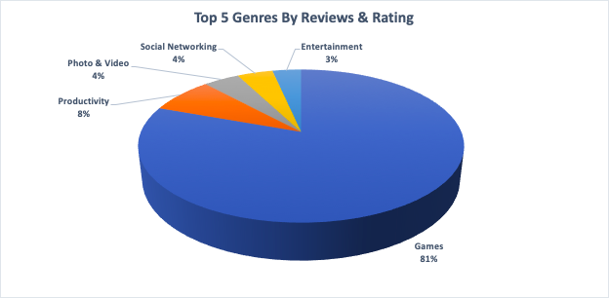
GENRE ANALYSIS
Notes:
After the first part of our analysis we found that our refined list of about 140 apps was comprised of over 80% games, followed by approx equal distribution of ….Now here’s my colleague Pam to tell you how we made our final selections.

Slide 7
OUR CRITERIA
App is on both the Apple App Store and Android Play Store platforms to maximize marketing cost
App cost is $1.00 or less = purchase price of $10,000
Rating of 4.5 or higher = 10 year lifespan
Analyzed Review and Install Counts to evaluate longevity and eliminate spyware

Slide 8










OUR RECOMMENDATIONS
WhatsApp Messenger
Instagram
Clash of Clans
Subway Surfers
Clash Royale
Candy Crush
Shadow Fight 2
Hay Day
Microsoft Word
Pics Art

Slide 9
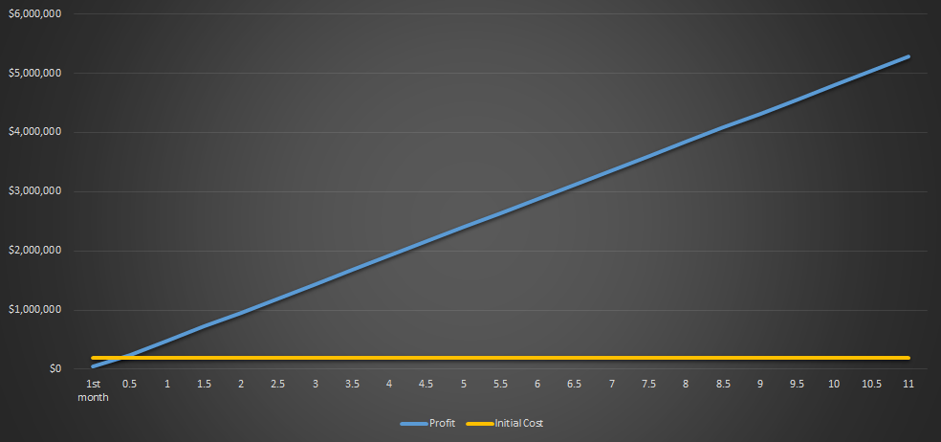
EXPECTED VALUE OF APPS
Over $5 Million In 11 Years
YEARS
Notes:
Months after your initial purchase you can expect to have already made your money back making these apps a low risk high reward option.

Slide 10
MEASURABLE OUTCOMES
Return on investment in 5 months
$2.4 Million made at 5 year mark
Over $5.25 Million return at 11+ year mark

Slide 11
OUTSIDE SOURCES
https://buildfire.com/what-type-of-apps-make-the-most-money
https://www.goldcoastbulletin.com.au/news/gold-coast/safety-warning-over-talking-cat-app-that-asks-kids-to-strip/news-story/f8136efb1251000f6e3c3e66cccebf4a
https://www.businessofapps.com/data/app-revenues/
Notes:
Here are some outside sources we used for reference and market research. Thank you, AppTrader for your time today and I hope you are excited about the app choices that we recommended. We think you will be happy with your return on investment. Are there any questions? We appreciate you choosing Hawkeye Data Analysis.
-confirmed that games and video make up a large majority of the app market revenue

